Slide 1
A Crack in the Code: Why software fails in scientific research, and how to fix it
Robert McGreevy
ISIS,
Science and Technology Facilities Council,
Rutherford Appleton Laboratory, Didcot, UK

Slide 2
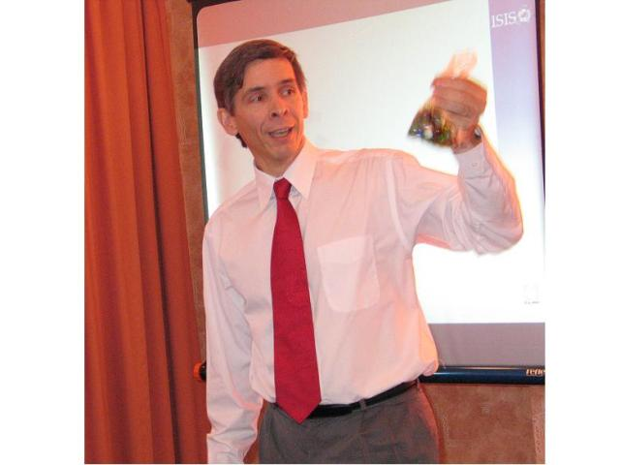
Who needs analysis software anyway?

Slide 3
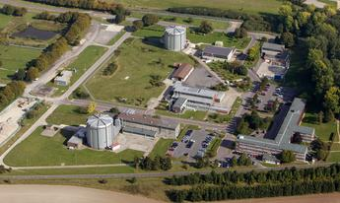
DIDO and PLUTO reactors – Harwell Laboratory 1970’s

Slide 4
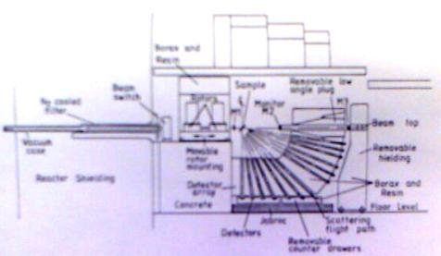
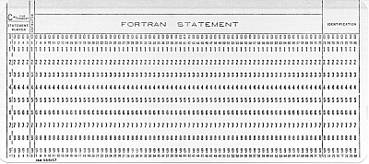
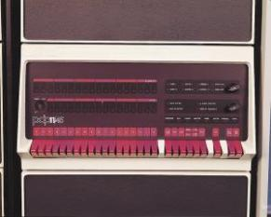
Detectors
Data
Data Acquisition

Slide 5
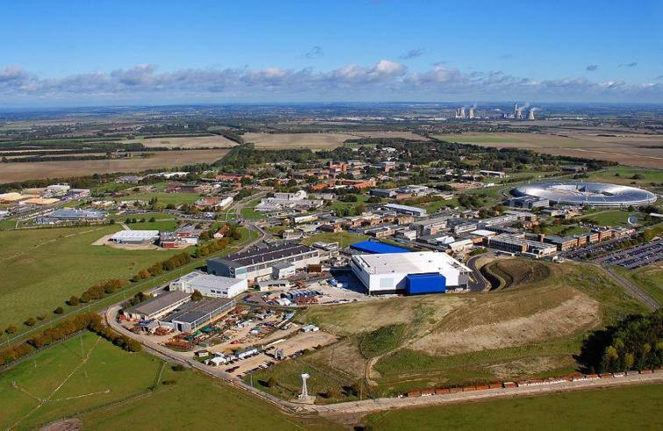
ISIS Facility – Rutherford Appleton Laboratory 2000’s

Slide 6
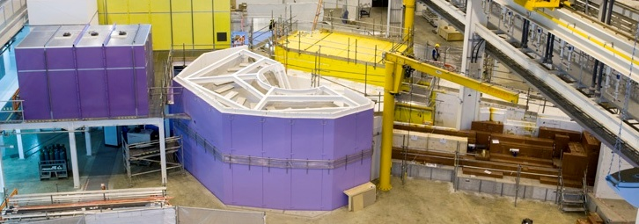
Data
Data Acquisition
Detectors


Slide 7
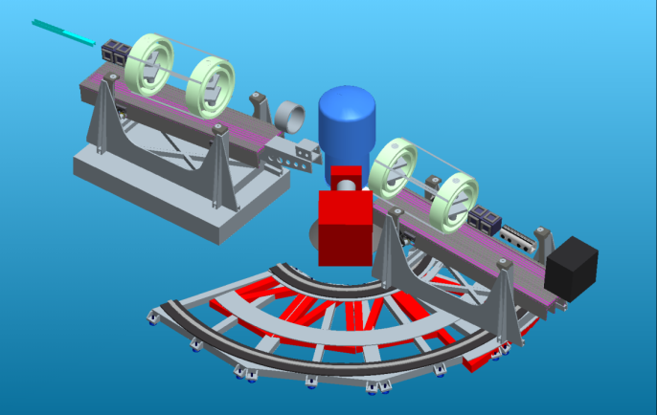
How we build technical hardware

Slide 8
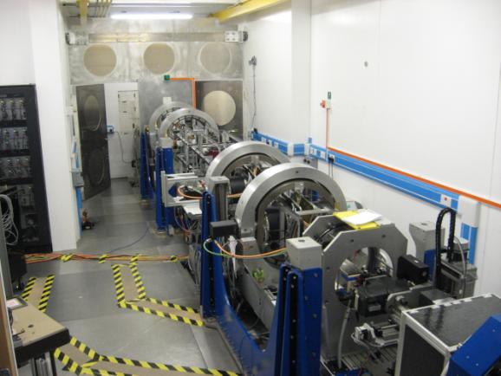
How we build technical hardware

Slide 9
How we build technical hardware

Slide 10

How we build analysis software

Slide 11
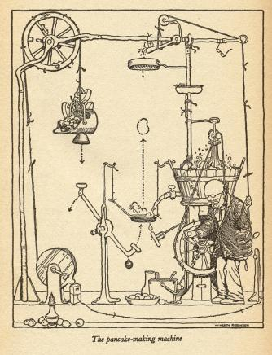
If the hardware engineers built this, we’d probably fire them ...
So why do we let the software engineers do it?

Slide 12
Well, we don’t normally use software engineers.
And anyway, it looks as though it will do the job!

Slide 13
Why?

Slide 14
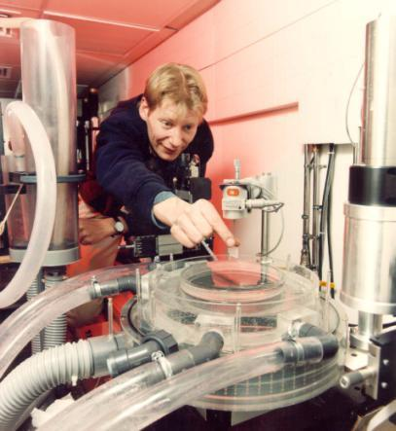
Scientists are clever people – of course they can write software,
when they’ve finished doing the experiment, fixing the equipment ...

Slide 15
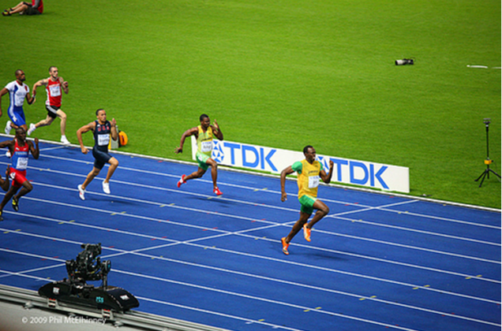
Software may give you the ‘scientific edge’

Slide 16
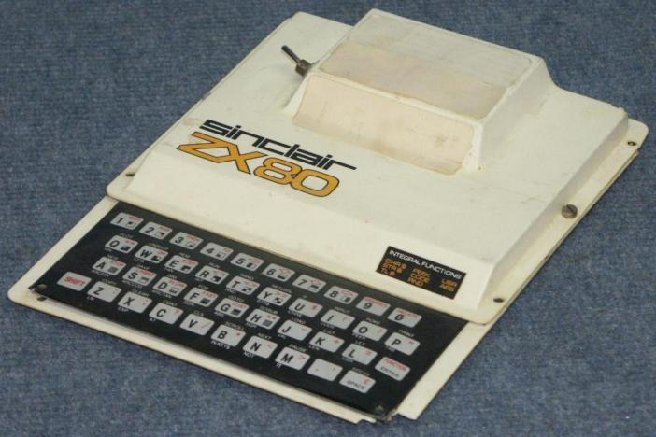
‘Senior scientists’ come from the ‘pre-PC’ generation

Slide 17
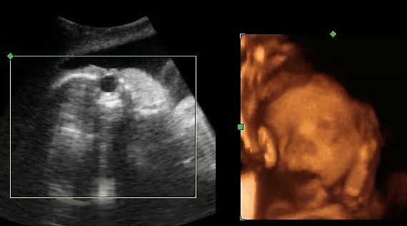
Real software costs real money

Slide 18









Software investment = hardware investment

Slide 19
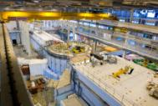
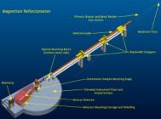
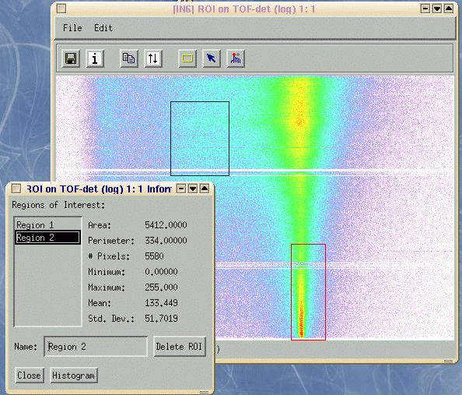
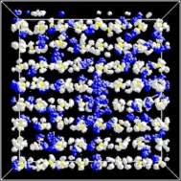
Source
Instruments
Sample environment
Data treatment
Scientific results

Slide 20


Source
Instruments
Sample environment
Data treatment
Scientific results

Slide 21
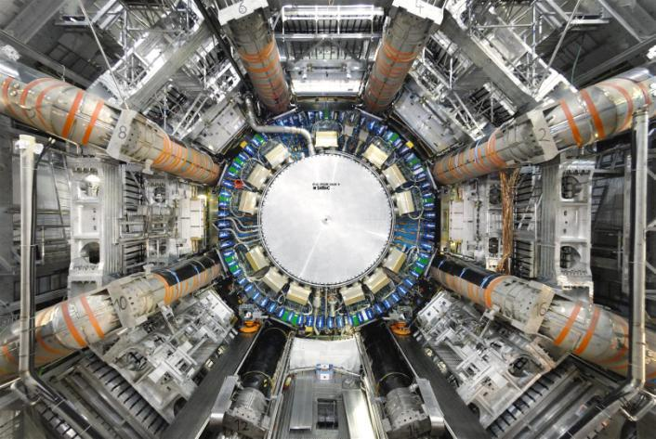
There are exceptions – e.g. the Large Hadron Collider

Slide 22
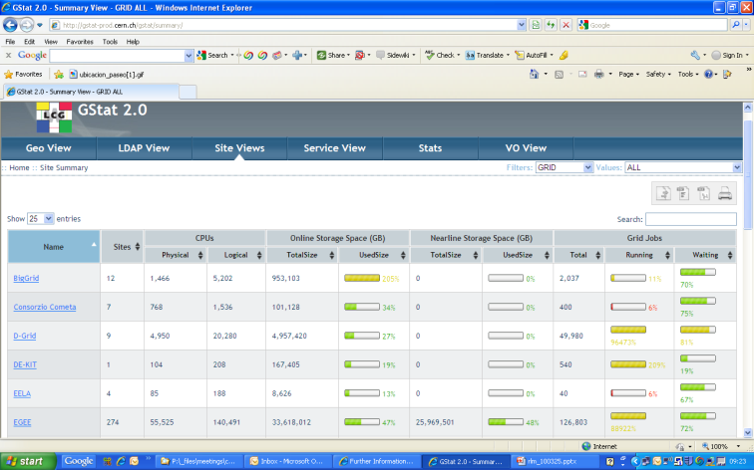
For which the analysis cost 100 M€ so far ...

Slide 23

The main problems ...
Single points of failure

Slide 24

The main problems ...
No career structure for
software developers

Slide 25
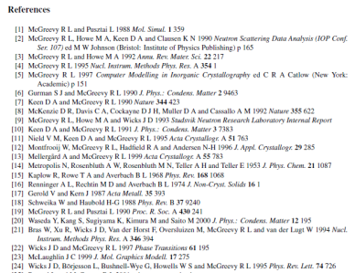
The main problems ...
No well established method
for citing (giving credit for)
software

Slide 26
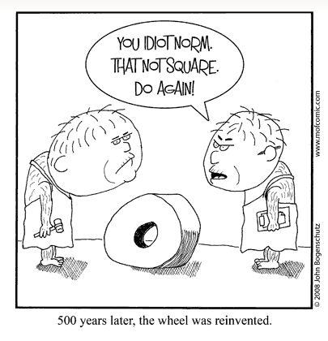
The main problems ...
Continual reinvention of
the wheel

Slide 27
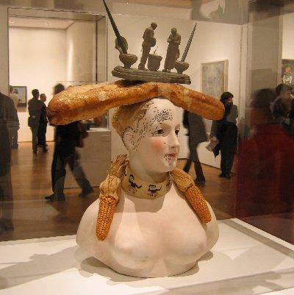
The main problems ...
Built but not designed?
It may be a work of art,
but is it science?

Slide 28


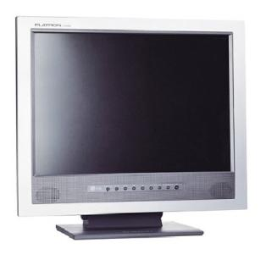
The main problems ...
Most effort on input and
output, not on the scientific
algorithms

Slide 29

The main problems ...
No documentation
William Shakespeare died without publishing any of the plays that he wrote. Several years after his death, when many corrupted versions of the plays were being printed, two friends, John Heminge and Henry Condell, decided to collect, edit, and publish all thirty-six of Shakespeare’s plays that they believed to be authentic.

Slide 30

So, when you don’t
know the answer...
... phone a friend

Slide 31
The challenges of scientific software management
Nick Draper
Tessella
Notes:
Hello,
I’m Nick Draper, I’ve been working for Tessella in the field scientific computing for 10 years, and managing projects teams for 5 of those. Working in a variety of Fields including Adaptive Clinical Trials, Biological data handling and drug discovery and more recently Neutron Scattering at ISIS.

Slide 32


Why scientific software projects fail
Project Structure Challenges
Unrealistic Schedules
Unrealistic Deadlines
Delayed start dates
Inappropriate Staffing
Lack of project management
Part time project staff
Inexperienced staff
Insufficient Budget
Software not considered during budget allocation
True cost of software failure not considered
Notes:
I’d like to start off by covering some of the reasons why scientific projects are challenging, and indeed why many fail to deliver what was expected within the resources available.
I’ve tried to group some of these issue into groups, the first of which are challenges associated with the setting up of the project structure and resources.
Unrealistic Schedules
Unrealistic Deadlines
Delayed start dates
Inappropriate Staffing
Lack of project management - Not considered a project at all
Part time project staff – Less commitment
Inexperienced staff
Insufficient Budget
Software not considered during budget allocation
True cost of software failure not considered

Slide 33
Why scientific software projects fail
Requirements Challenges
Understanding scientific requirements
To “speak the language of science” requires a scientific background
Changing Requirements
Experimentation if fundamental to science
Requirements will change
The challenge is to manage that change
Notes:
Requirements Challenges
Understanding scientific requirements
To “speak the language of science” requires a scientific background
Changing Requirements
Experimentation is fundamental to science
Often the point of software is to enable new science and therefore new requirements
Requirements will change
The challenge is to manage and adapt efficiently to that change

Slide 34


Why scientific software projects fail
Poor Project Management
Project Methodology choice
Selecting the right methodology
Adapting it to fit the project environment
Communication
Gaining buy in from scientists
Wide International user groups
Project tracking
Projects slip in small steps
Active monitoring required to address this
Notes:
Poor Project Management
Project Methodology choice
Selecting the right methodology
Adapting it to fit the project environment
Communication
Gaining buy in from scientists
Wide International user groups
Project tracking
Projects slip in small steps
Active monitoring required to address this

Slide 35

Why scientific software projects fail
Poor Quality
Lack of Quality Assurance
Code documentation
Design reviews
Testing in the Production Environment
Aka letting the users test it
Inadequate Testing
Unit testing
Integration testing
Performance/Stress testing
Notes:
Poor Quality
Lack of Quality Assurance
Code documentation
Design reviews
Testing in the Production Environment
Aka letting the users test it – Nothing alienates users faster than buggy and incomplete software
Inadequate Testing
Unit testing
Integration testing
Performance/Stress testing

Slide 36
Why scientific software projects fail
Project Support
User documentation
User training
Design documentation
Maintenance documentation
User Contribution procedures
Notes:
Project Support – Often ignored, although valued highly by users
User documentation
User training
Design documentation
Maintenance documentation
User Contribution procedures

Slide 37

Instrument Independent Data Reduction and Analysis
Nick Draper
Tessella
Notes:
Next I’d like to introduce you to the project that I’ve been managing for ISIS for the last few years.
Mantid is a data analysis framework for handling the data reduction and analysis for Neutron and Muon Data.
I’ll use this as an example to describe some of the issues as they applied to this project, and the solutions we used for Mantid.
These examples may help you as background for similar issues in your project, but the correct solution for you depends on your particular project environment and issues.

Slide 38
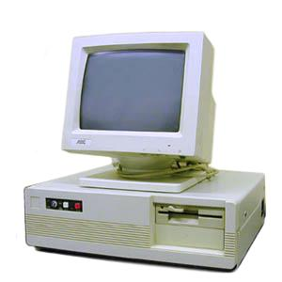
Project History
Previous software
Developed separately by scientists / students
Lots of repeated work
Not actively maintained
Patchy documentation
No user consistency
Unable to cope new data
Business Case
Developed with a business focussed software company
Created a good business case
Alienated scientist user base
Communication and expectation issues
Notes:
First to set the scene I’ll tell you a bit about the Mantid project and it’s history
Previous software
Developed separately by scientists / students
Lots of repeated work
Not actively maintained
Patchy documentation
No user consistency
Unable to cope new data
Business Case
Developed with a business focussed software company
Created a good business case
Alienated scientist user base
Communication and expectation issues

Slide 39

Project Goals
Goals
Consolidate the data analysis software for ISIS without restricting the needs of the instrument scientists
Key requirement
Create a Data Analysis framework
not instrument or technique/dependent
Cross-platform
Windows, Linux, Mac
Easily extensible
Freely redistributable
Notes:
So through the efforts of Robert and some of his group leaders the Mantid project was started, and was the first project at ISIS to be both properly funded, but also professioanlly project managed. But it had a challenging goal.
Consolidate the data analysis software for ISIS without restricting the needs of the instrument scientists
And several key requirements
Create a Data Analysis framework
not instrument or technique/dependent
Cross-platform
Windows, Linux, Mac
Easily extensible
Freely redistributable

Slide 40

Ensuring good communication
Users Concerns
Software project scepticism
Previous software projects had not gone well
Feeling of a lack of control
Each different science group has unique requirements
Considered the problem too large
Previous projects had only tackled one technique or provided basic support
Notes:
So one of the project management challenges was to ensure good communication between the instrument scientists and wider user base without placing such a burden on the project that all we ever do is talk about things and never get the chance to deliver.
Users Concerns
Software project scepticism
Previous software projects had not gone well
Feeling of a lack of control
Each different science group has unique requirements
Considered the problem too large
Previous projects had only tackled one technique or provided basic support across a wider range

Slide 41
Solution – Software led by Scientists
Users
Scientific Steering Committee
Development Team
27 beamlines, 1600 users
9 Key scientists representing every beamline.
PM & 7 Developers
Notes:
So we had to engage the scientists and give them control in the direction of the project.
Now we couldn’t talk in depth to all of the 1600 users of ISIS, or indeed all of the instrument scientists for every beamline.
So we set up a scientific steering committee that enable that two way communication, and control the project direction through introducing and prioritising requirements for the development team to concentrate on.

Slide 42

Development methodology
Project Challenges
Changing requirements
Responsiveness Vs. Robustness
Scientist involvement
Quality assurance Vs. Overhead
Solution - Agile Iterative development
Why?
Adaptability - rapidly respond to changes
Value - continuous delivery of more useful functionality
Visibility - stakeholder collaboration and validation
Risk - the reduction in overall project risk as a result
Notes:
There come a time near the start of every project where you need to consider how you should actually manage and perform the development.
You need to select a development methodology that best matches the challenges of your particular project.
In the case of Mantid the prime challenges were
Handling the changing scientific requirement
Ensuring the project was responsive to changing requirements without sacrificing too much robustness of the code
Doing this allows you to keep the scientists involved at a much closer level, and keeps them buying into the project
The need to balance Testing and other QA activities against the time and resource required to do them

Slide 43

Solution – Iterative Development Process
Requirements
Design
Development
Testing
Release

Slide 44

Why not Scrum, XP, DSDM?
Agile development
Broad term
Scrum, XP, DSDM are specific examples
All have useful approaches
And expected prerequisites
User secondment
Continuous design
Pair programming
Fixed timeboxing
These rarely fit perfectly with scientific programming
Mould the methodology to fit the project
Not vice versa
Notes:
For those of you who know a little about the different development methodologies you might say, that sounds a bit like Scrum, or DSDM. So Why not actually use scrum?
Well those are all examples of agile development methodologies.
All of these examples have useful approaches
but also have expected prerequisites such as
User secondment
Continuous design
Pair programming
Fixed timeboxing
These rarely fit perfectly with scientific programming
It is important to mould the methodology to fit the project
Not vice versa

Slide 45

Release Process
Project Challenges
Iterative development - Frequent releases
Testing Vs. release overhead
Rapid interaction with scientists
Solution - Automation and Dual release streams
Official releases: 4-6 weeks apart
Manual, performance and usability testing
Release notes, announcements, documentation, training
Development releases: Daily
Automated unit and system tests
Rapid response to issues, interactive development
Notes:
So one of the aspects of agile development is frequent releases of you code.
Of course any release of your code must be tested and that adds overhead to every release you do, and that is before you consider
writing release notes
packaging the software
informing all your users
and training on the new functionality.
Now all of this extra work may make you think that you don’t want to do releases too frequently, but you cannot underestimate the value of being able to work closely with the instrument scientists.
To be able to develop something to a possible vague guideline and immediately provide him a working copy of his code for feedback. Or be able to produce very rapid releases to solve time critical issues.
Solution - Automation and Dual release streams
Official releases: 4-6 weeks apart
Manual, performance and usability testing
Release notes, announcements, documentation, training
Development releases: Daily
Automated unit and system tests
Rapid response to issues, interactive development

Slide 46


Continuous Integration Environment
Deploy to
Download site
Mantid Project Wiki
Automated System test
SVN Repository
Build + unit test
-Linux
-Mac OSX
-Windows 32
-Windows 64
trac Issue
tracking
system
Developers

Slide 47

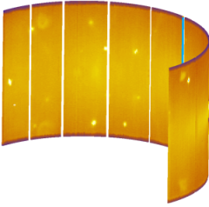
Design Challenges
Flexibility
Framework for Data Analysis
not instrument or technique/dependent
Large and growing list of Algorithms
Easily extensible
Non Functional
Cross-platform
Windows, Linux, Mac
Large datasets
Strict performance requirements
Notes:
Flexibility
Framework for Data Analysis
not instrument or technique/dependent
Large and growing list of Algorithms
Easily extensible
Non Functional
Cross-platform
Windows, Linux, Mac
Large datasets
Strict performance requirements

Slide 48
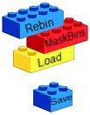
Design Criteria
Separation of Data and Algorithms
Encapsulated “User Code”
Algorithms
Workspaces
Use of well designed interfaces
Reuse of existing components
Careful memory management
Graceful degradation
Powerful, but easy to use scripting
To build individual analysis chains from separate algorithms
Notes:
Separation of Data and Algorithms
Encapsulated “User Code”
Algorithms
Workspaces
Use of well designed interfaces
Reuse of existing components
Careful memory management
Graceful degradation
Powerful, but easy to use scripting
To build individual analysis chains from separate algorithms – like lego

Slide 49
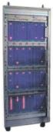

Architectural Design - Overview
DAE direct access
MantidScript
Command line & Scripting interface
Mantid Framework
RAW data files
API
Algorithms
Workspaces
MantidPlot Graphing and analysis
NEXUS data files
User Defined
User Defined
Matlab Interface
Instrument log files
Future Instrument specific UI
Future Instrument specific UI

Slide 50
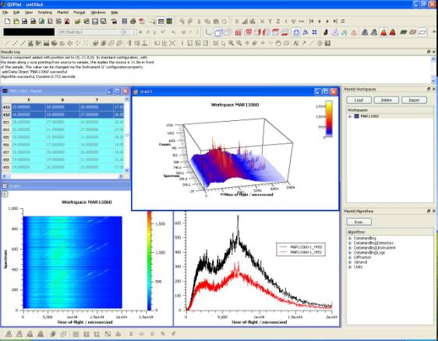
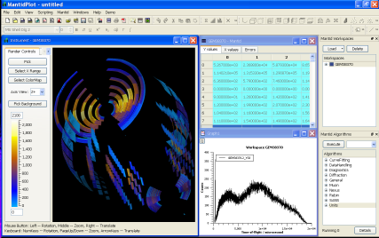
User Interfaces
Current Interfaces
MantidPlot
Data interaction and analysis
Data visualization
Instrument visualization

Slide 51
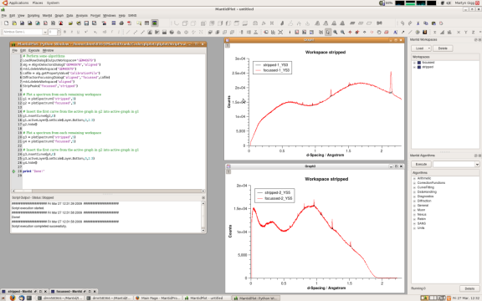
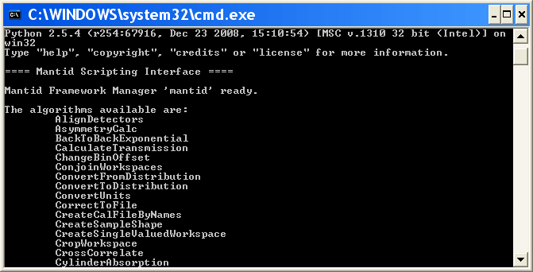
User Interfaces
Current Interfaces
Python
Command line access and scripting
Python scripting language

Slide 52
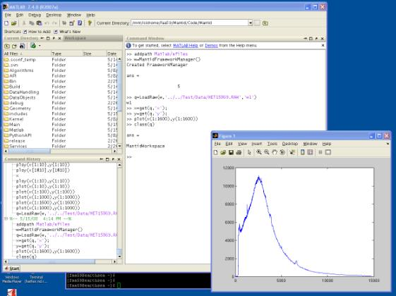
User Interfaces
Current Interfaces
Matlab Interface
Data interaction and analysis
Further data manipulation and vizualization using Matlab

Slide 53






Collaborations
Also used at
Interest from

Slide 54
Further Information
Mantid Project
www.mantidproject.org
Tessella
www.tessella.com
ISIS pulsed muon and neutron source
www.isis.rl.ac.uk
SNS Spallation neutron source
neutrons.ornl.gov
Notes:
Summary:
Plan your software work as a project
Fund it appropriately
Staff it with motivated, skilled people that have enough time
Project management is essential for anything other than very small projects
Do not jump into development
Take time to gather and analyse the requirements
Every day spent on design can remove three days of development
Project documentation is key to maintainability
Tests aren’t just for now, they are for the future, so automate and document

Slide 55
Questions?

